Slide 1
UNIT 1 - BASICS OF CELL BIOLOGY
Dr. G. Praveen Kumar, Asst. Professor,
Dept. of Chemistry

Slide 2
UNIT 1 - BASICS OF CELL BIOLOGY
INTRODUCTION TO THE CELL
STRUCTURE AND FUNCTIONS OF THE CELL
INTERNAL ORGANIZATION OF CELL
PARTS OF THE PROKARYOTIC AND EUKARYOTIC CELL
GENETIC INFORMATIONS OF THE CELL

Slide 3
CELL DIVISION- MITOSIS AND MEOSIS
CELL DIFFERENTIATION
PROTEIN STRUCTURE
CELL METABOLISM
HOMEOSTASIS

Slide 4
INTRODUCTION TO THE CELL
Both living and non-living things are composed of molecules made from chemical elements such as Carbon, Hydrogen, Oxygen, and Nitrogen.
The organization of these molecules into cells is one feature that distinguishes living things from all other matter.
The cell is the smallest unit of matter that can carry on all the processes of life.

Slide 5
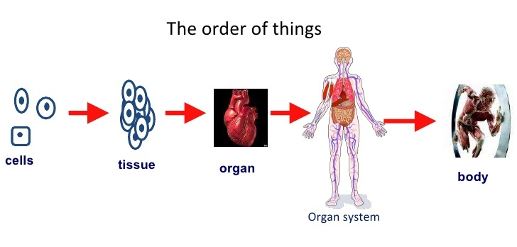
Five orders of organization

Slide 6
Kingdoms and Classification
Classification is grouping things together on the basis of features they have in common.
The science of classification is called taxonomy.
In 1982, Margulis and Schwartz proposed a system which used the five kingdom classification of living organisms the prokaryote and four eukaryote kingdoms. Those are as follows
1) Monera ( Prokaryotes)
2) Protista
3) Fungi
4) Plantae
5) Animalia

Slide 7
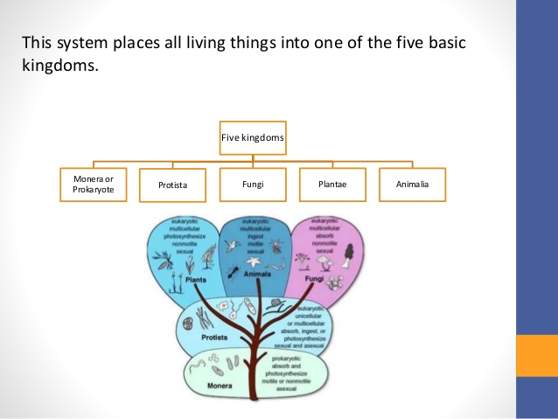

Slide 8
Monera (Prokaryotae) : Single cell and don’t have definite nucleus.
Prokaryotes are bacteria and cyanobacteria. They were autotrophic or heterotrophic, motile or non-motile. Examples, blue-green bacteria.
2) Protista: single cell but have nuclear membrane.
These organisms resembling the ancestors of plants, animals, and fungi. Include algae, protozoa, slime molds,
3) Fungi
Heterotrophic, non-motile, food is digested the outside of the body and products of digestion absorbed.
ex. Yeast, mushrooms.
4) Plantae
Plants, autotrophic, non-motile.
5) Animalia
Animals are heterotrophic, motile, food is ingested (taken to the body) before digestion.

Slide 9
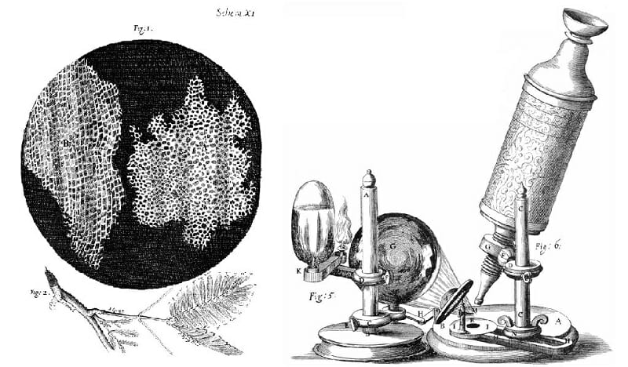
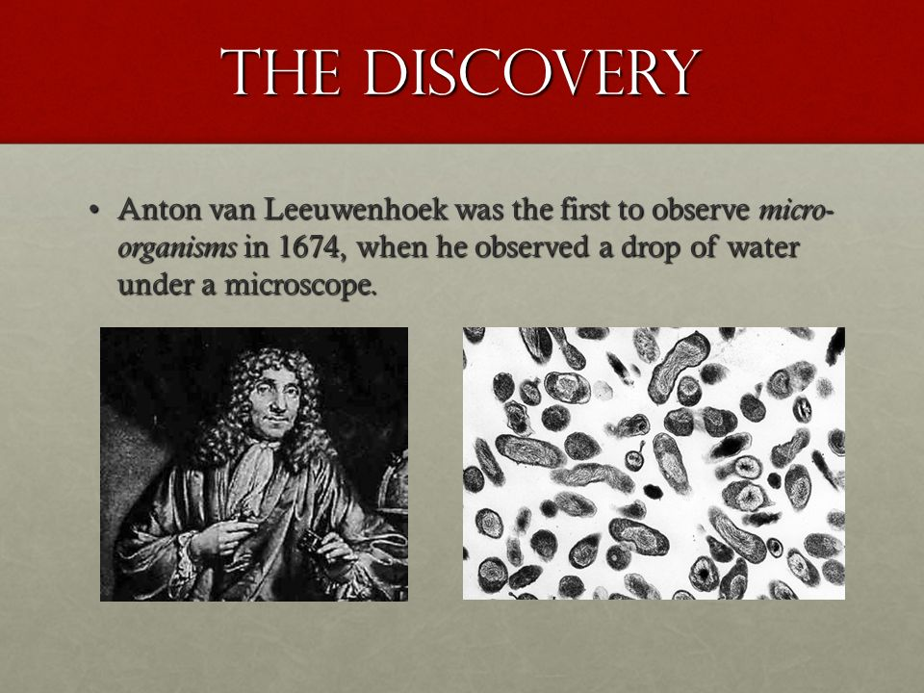
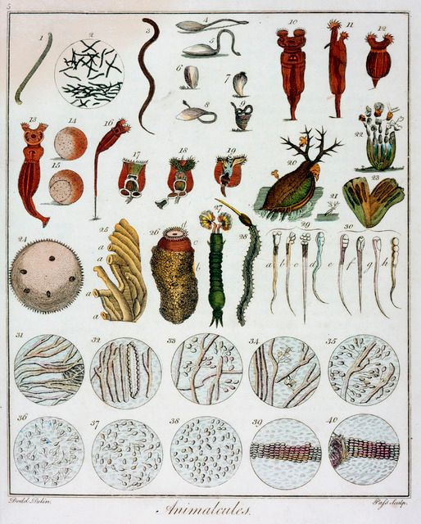
History
Every living thing - from the tiniest bacterium to the largest whale - is made of one or more cells.
Before the C17th, no one knew that cells existed, since they are too small to be seen with the naked eye.
The invention of the microscope enabled Robert Hooke, (1665) and Anton van Leuwenhoek (1675) to see and draw the first ‘cells’, a word coined by Hooke
The idea that all living things are made of cells was put forward in about 1840 and in 1855 came ‘Cell Theory’ – i.e. ‘cells only come from other cells’ – contradicting the earlier theory of ‘Spontaneous Generation’

Slide 10
Cell Theory
The cell theory was proposed by Matthias Schleiden and Theodor Schwann in 1839.
Cell Theory consists of three principles:
a. All living things are composed of one or more cells.
b. Cells are the basic units of structure and function of an organism.
c. Cells come only from the replication of existing cells.
The new version of the cell theory can also include:
d. Cells carry genetic material passed to daughter cells during cellular division
e. All cells are essentially the same in chemical composition.
f. Energy flow (metabolism and biochemistry) occurs within cells.

Slide 11
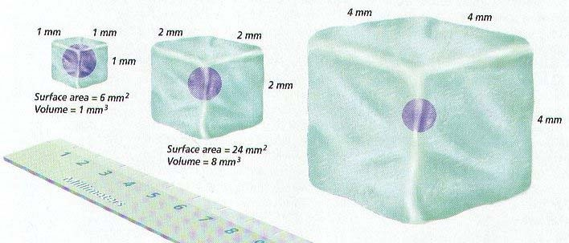
CELL SIZE
Most cells are small for two main reasons:
The cell’s nucleus can only control a certain volume of active cytoplasm.
Cells are limited in size by their surface area to volume ratio.
A group of small cells has a relatively larger surface area than a single large cell of the same volume.
This is important because the nutrients, oxygen, and other materials a cell requires must enter through it surface.
Fick’s Law – Rate of diffusion α Surface Area x Concentration Difference
Distance

Slide 12
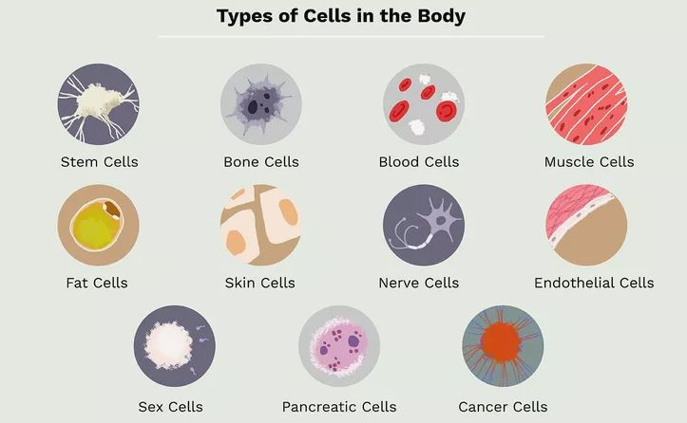
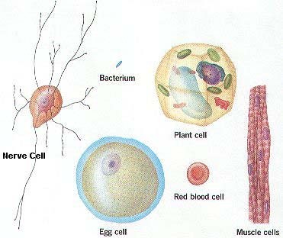
CELL SHAPE
Cells come in a variety of shapes – depending on their function

Slide 13
Internal Organization of Cell
Cells contain a variety of internal structures called organelles
organelle is a cell component that performs a specific function in that cell.
The entire cell is surrounded by a thin cell membrane.
The nucleus, mitochondria and chloroplasts all have double membranes called envelopes.
Because membranes are fluid mosaics, the molecules making them up – phospholipids and proteins - move independently.
Proteins in the membrane can be used to transport substances across the membrane – e.g. by facilitated diffusion or by active transport.
The proteins on the outside of cell membranes identify us as unique.

Slide 14
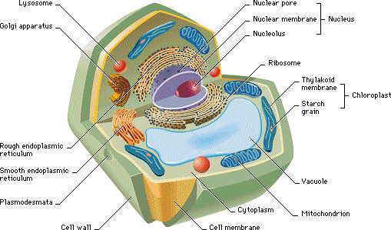
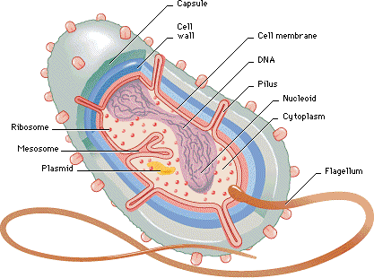
Prokaryotes v. Eukaryotes
Organisms whose cells normally contain a nucleus are called Eukaryotes
Those (generally smaller) organisms whose cells lack a nucleus and have no membrane-bound organelles are known as Prokaryotes.
A. Prokaryotic cell (bacterium)
B. Eukaryotic cell (plant)

Slide 15
PARTS OF THE EUKARYOTIC CELL
Eukaryotic cells generally have three main components: A cell membrane, a nucleus, and a variety of other organelles.
THE CELL MEMBRANE
A cell cannot survive if it is totally isolated from its environment.
The cell membrane is a complex barrier separating every cell from its external environment.
This "Selectively Permeable" membrane regulates what passes into and out of the cell.
The cell membrane is a fluid mosaic of proteins floating in a phospholipid bilayer.
cell membrane functions like a gate, controlling which molecules can enter and leave the cell.
The cell membrane controls which substances pass into and out of the cell.
The rest of the cell membrane is mostly composed of phospholipid molecules.

Slide 16
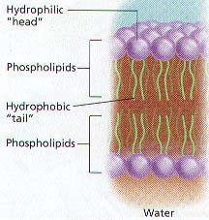
CONT.
The head is charged and so polar; the tails are not charged and so are non-polar.
Thus the two ends of the phospholipid molecule have different properties in water.
The phosphate head is hydrophylic and so the head will orient itself so that it is as close as possible to water molecules.
The fatty acid tails are hydrophobic and so will tend to orient themselves away from water.
This causes the phospholipids of the cell membrane to form two layers, known as a phospholipid bilayer.

Slide 17
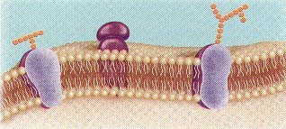
FLUID MOSAIC MODEL OF CELL MEMBRANES
Membranes are fluid and are rather viscous
The molecules of the cell membrane are always in motion, so the phospholipids are able to drift across the membrane, changing places with their neighbour.
Proteins, both in and on the membrane, form a mosaic, floating in amongst the phospholipids.
Because of this, Singer and Nicolson call the modern view of membrane structure the ‘Fluid Mosaic Model’. The mosaic of proteins in the cell membrane is constantly changing.

Slide 18
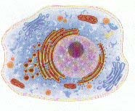
CYTOPLASM
Within the cell membrane which is not the nucleus is known as the cytoplasm.
Cytosol is the jelly-like mixture in which the other organelles are suspended, so cytosol + organelles = cytoplasm.
Organelles carry out specific functions within the cell. In Eukaryotic cells, most organelles are surrounded by a membrane, but in Prokaryotic cells there are no membrane-bound organelles.

Slide 19
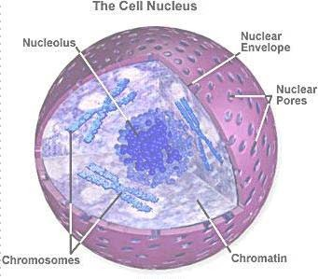
THE NUCLEUS (pl. NUCLEI)
The nucleus is normally the largest organelle within a Eukaryotic cell
Prokaryotes have no nucleus, having a nuclear body instead
The nucleus contains the cell’s chromosomes (human 23, fruit fly 6, fern 1260) which are normally uncoiled to form a chromatinic network, which contain both linear DNA and proteins, known as histones
The nucleus is surrounded by a double membrane called the nuclear envelope, which has many nuclear pores through which mRNA, and proteins can pass
Most nuclei contain at least one nucleolus (plural, nucleoli). The nucleoli are where ribosomes are synthesized
Ribosomes translate mRNA into proteins, when a nucleus prepares to divide, the nucleolus disappears

Slide 20
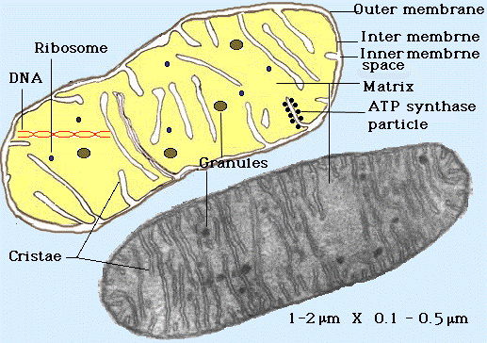
MITOCHONDRIA
Mitochondria are found scattered throughout the cytosol, and are relatively large organelles (second only to the nucleus and chloroplasts)
Mitochondria are the sites of aerobic respiration, in which energy from organic compounds is transferred to ATP. For this reason they are sometimes referred to as the ‘powerhouse’ of the cell.
ATP is the molecule that most cells use as their main energy ‘currency’.
The smooth outer membrane serves as a boundary between the mitochondria and the cytosol.
The inner membrane has many long folds, known as cristae, which greatly increase the surface area of the inner membrane, providing more space for ATP synthesis to occur.
Mitochondria have their own DNA, and new mitochondria arise only when existing ones grow and divide. They are thus semi-autonomous organelles.

Slide 21
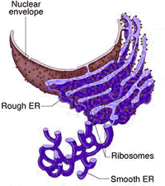
ENDOPLASMIC RETICULUM (ER)
The ER is a system of membranous tubules and sacs.
The primary function of the ER is to act as an internal transport system, allowing molecules to move from one part of the cell to another.
The rough ER is studded with 80s ribosomes and is the site of protein synthesis.
The smooth ER is where polypeptides are converted into functional proteins and where proteins are prepared for secretion.
Smooth ER has no 80s ribosomes and is also involved in the regulation of calcium levels in muscle cells, and the breakdown of toxins by liver cells.
Both types of ER transport materials throughout the cell.

Slide 22
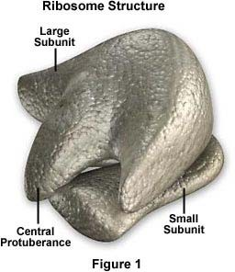
RIBOSOMES
Most other organelles, ribosomes are not surrounded by a membrane.
Ribosomes are the site of protein synthesis in a cell.
Some are free in the cytoplasm (Prokaryotes); others line the membranes of rough endoplasmic reticulum (rough ER).
They exist in two sizes:
70s are found in all Prokaryotes, chloroplasts and mitochondria, suggesting that they have evolved from ancestral Prokaryotic organisms. They are free-floating.
80s found in all eukaryotic cells – attached to the rough ER (they are rather larger).
Groups of 80s ribosomes, working together, are known as a polysome

Slide 23
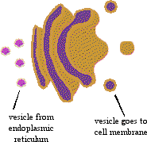
GOLGI APPARATUS
The Golgi apparatus is the processing, packaging and secreting organelle of the cell, so it is much more common in glandular cells.
The Golgi apparatus is a system of membranes, made of flattened sac-like structures called cisternae.
It works closely with the smoother, to modify proteins for export by the cell.

Slide 24
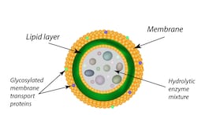
LYSOSOMES
Lysosomes are small spherical organelles that enclose hydrolytic enzymes within a single membrane.
Lysosomes are the site of protein digestion
They are also the site of food digestion in the cell, and of bacterial digestion in phagocytes
Lysosomes are formed from pieces of the Golgi apparatus that break off.
They are frequently nicknamed as “suicide bags or sacs” due to autolysis
Lysosomes are common in the cells of Animals, Protoctista and even Fungi, but rare in plants.

Slide 25
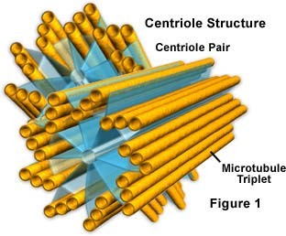
CENTRIOLE
This consists of two bundles of microtubules at right-angles to each other.
Each bundle contains 9 tubes in a very characteristic arrangement
At the start of mitosis and meiosis, the centriole divides, and one half moves to each end of the cell, forming the spindle.
The spindle fibres are later shortened to pull the chromosomes apart.

Slide 26
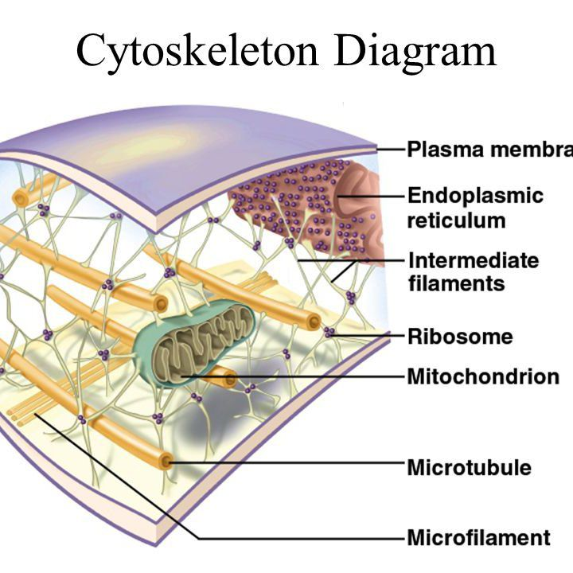
CYTOSKELETON
Just as your body depends on your skeleton to maintain its shape and size, so a cell needs structures to maintain its shape and size.
In animal cells, which have no cell wall, an internal framework called the cytoskeleton maintains the shape of the cell, and helps the cell to move.
The cytoskeleton consists of two structures:
microfilaments (contractile). They are made of actin, and are common in motile cells.
microtubules (rigid, hollow tubes – made of tubulin).
Microtubules have three functions:
To maintain the shape of the cell.
To serve as tracks for organelles to move along within the cell.
They form the centriole.

Slide 27
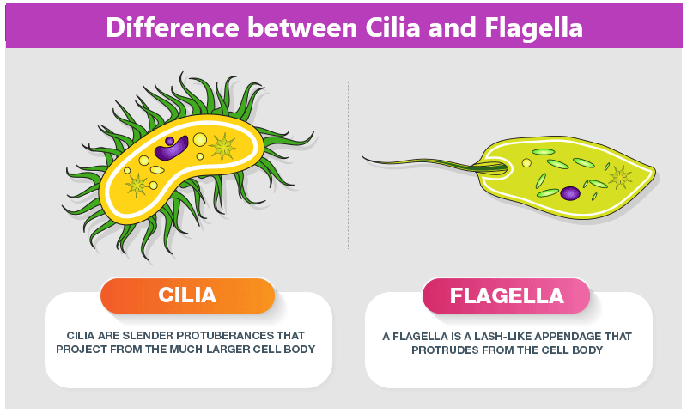
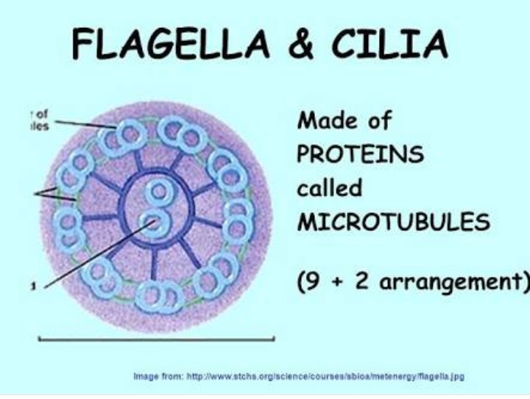
CILIA AND FLAGELLAE
Cilia and Flagellae are structures that project from the cell, where they assist in movement
Cilia (sing. cilium) are short, and numerous and hair-like
Flagellae (sing. flagellum) are much longer, fewer, and are whip-like
The cilia and flagellae of all Eukaryotes are always in a characteristic arrangement of ‘9 + 2’
Protoctista commonly use cilia and flagellae to move through water
Sperm use flagellae (many, all fused together) to swim to the egg
Cilia line our trachea and bronchi, moving dust particles and bacteria away from the lungs

Slide 28
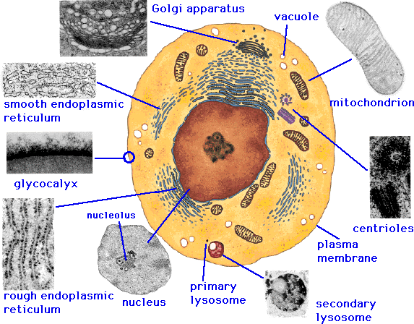
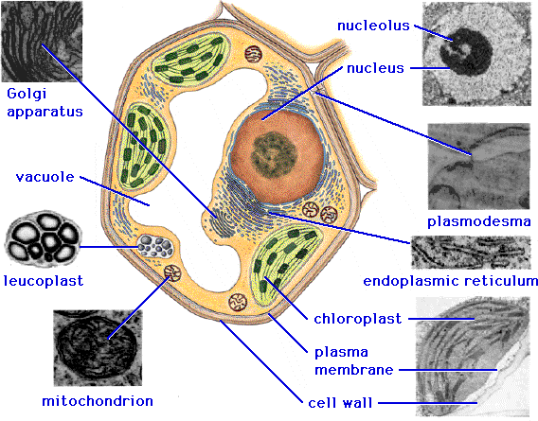
An animal cell
A plant cell

Slide 29
 | Prokaryotes | Eukaryotes
Typical organisms | bacteria | Protoctista, fungi, plants, animals
Typical size | ~ 1-10 µm | ~ 10-100 µm (sperm cells) apart from the tail, are smaller)
Type of nucleus | Nuclear body No nucleus | real nucleus with nuclear envelope
DNA | circular (ccc DNA) | linear molecules (chromosomes) with histone proteins
Ribosomes | 70S | 80S
Cytoplasmatic structure | very few structures | highly structured by membranes and a cytoskeleton
Cell movement | Flagellae/cilia made of flagellin | flagellae and cilia made of tubulin
Mitochondria | none | 1 - 100 (though RBC’s have none)
Chloroplasts | none | in algae and plants
Organization | usually single cells | single cells, colonies, higher multicellular organisms with specialized cells
Cell division | Binary fission (simple division) | Mitosis (normal cell replication) Meiosis (gamete production)

Slide 30
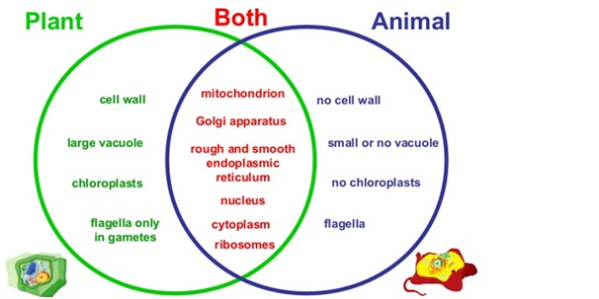

Slide 31
THANK YOU

